Slide 1


HTML 5
New markups
and attributes

Slide 2

HTML5 - New markups
Course objectives
By completing this course, you will be able to:
Use new semantic markups
Validate form fields without JavaScript
Use new form input types
Play media resources without plugins
Make accessible widgets thanks to ARIA
Structure your data markup with Microdatas

Slide 3


HTML5 - New markups
Course topics
Course’s plan:
Semantic Markups
Web Form
Media Markups
ARIA
Microdata

Slide 4
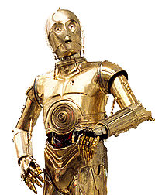
Semantic markups
HTML5 - New markups

Slide 5

Semantic markups
Presentation
Semantic elements describe their meaning or purpose clearly to the browsers
With HTML5, no more overuse of the div tag to define a division or a section
Doesn’t tell us anything about its content
Doesn’t convey any clear meaning

Slide 6
Semantic markups
Semantic
Most websites have some common uses of generic blocks:
<div id="header">
<div id="nav">
<div class="article">
<div id="sidebar">
<div class="section">
<div id="footer">

Slide 7
Semantic markups
Semantic
HTML5 introduces the following new markups:
<header>
<nav>
<article>
<sidebar>
<section>
<footer>

Slide 8
<body>
<header><!-- Header content --></header>
<article>
<section>
<!-- Section content -->
</section>
<section>
<!-- Other section content -->
</section>
</article>
<aside>
<!-- Aside content -->
</aside>
<footer><!-- Footer content --></footer>
</body>
Semantic Example

Slide 9
Semantic markups
Section
The section element represents a generic section of a document
A chapter for example
<section>
<h1>Chapter 2 : Basic HTML tags</h1>
<p>
HTML markup consists of several key components, including elements […], character-based data types, character references and entity references
</p>
</section>

Slide 10
Semantic markups
Section
The section element is not a generic container element
Use div when an element is needed only for styling purposes or as a convenience for scripting
Use article when it would make sense to syndicate the contents of the element

Slide 11
Semantic markups
Article
The article element represents a self-contained composition independently distributable or reusable
News
Blog posts
…
<article id="comment-6">
<header>
<h4>John Doe</h4>
</header>
<p>Very good course ;-)</p>
</article>

Slide 12
Semantic markups
Nav
The nav element represents a section of navigation links
<nav>
<h1>Navigation</h1>
<ul>
<li><a href="/">Home</a></li>
<li><a href="/about.html">About</a></li>
</ul>
</nav>

Slide 13
Semantic markups
Header
The header element represents the header of a section
<header>
<h1>Introduction to HTML5</h1>
<p class="author-line">By Brice Argenson</p>
</header>

Slide 14
Semantic markups
Footer
The footer element represents a footer for its nearest ancestor sectioning content
<footer>
<p>© 2012 SUPINFO International University</p>
</footer>

Slide 15
Semantic markups
Address
The address element represents the contact information for its nearest article or body element ancestor
<footer>
<address>
For more details, contact
<a href="mailto:js@example.com">John Smith</a>.
</address>
<p><small>© Copyright 2042 Plop Corp.</small></p>
</footer>

Slide 16
Semantic markups
Hgroup
The hgroup element represents the heading of a section
Used to group a set of h1–h6 elements when the heading has multiple levels
Such as subheadings, alternative titles, or taglines

Slide 17
Semantic markups
Hgroup
Example:
<hgroup>
<h1>HTML5</h1>
<h2>Or: How to design modern Web Applications</h2>
</hgroup>

Slide 18
Semantic markups
Headings and sections
The h1–h6 elements and the hgroup element are headings
The first in a section represents the heading for that section

Slide 19
Semantic markups
Headings and sections
Subsequent headings
of equal or higher rank:
start new (implied) sections
of lower rank:
start implied subsections that are part of the latter

Slide 20
Semantic markups
Semantically equivalent
<body>
<h1>HTML5</h1>
<h2>Offline Webapps</h2>
<h3>LocalStorage</h3>
<h2>New Markups</h2>
</body>
<body>
<h1>HTML5</h1>
<section>
<h1>Offline Webapps</h1>
<section>
<h1>LocalStorage</h1>
</section>
</section>
<section>
<h1>New Markups</h1>
</section>
</body>

Slide 21


Questions ?

Slide 22

WEB forms
HTML5 - New markups

Slide 23
Web Forms
Presentation
HTML5 introduce an update to the forms features found in HTML4
Add support for common needs like
Basic data typing
Simpler validation on the client side
XML submission
…

Slide 24
Web Forms
Client-side validation
Forms can be annotated to check the user's input before the form is submitted
Allows the user to avoid the wait of a validation by the server
Before HTML5, we used JavaScript to do that
Notes:
The server still has to verify the input is valid (since hostile users can easily bypass the form validation), but it allows the user to avoid the wait incurred by having the server be the sole checker of the user's input.

Slide 25
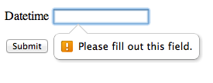
Web Forms
Client-side validation
HTML5 introduce the required annotation
With it, an input can’t be submitted until a value is given
<p>
<label>
Datetime: <input type="datetime" required />
</label>
</p>

Slide 26
Web Forms
Client-side validation
It is also possible to limit the length of the input, using the maxlength attribute
<p>
<label>
Comments: <textarea name="comments" maxlength="160"/>
</label>
</p>

Slide 27
Web Forms
Client-side validation
The pattern attribute allows you to specifies a RegEx that the control’s value has to match
<label>
Course Code: <input type="text" pattern="[1-5][A-Z]{3}"/>
</label>

Slide 28
Web Forms
Client-side validation
The min and max attributes indicate the allowed range of values for the element
<label>
Birthday: <input type="date" min="1900-12-31" />
</label>
<label>
Quantity: <input type="number" min="1" max="20" />
</label>

Slide 29
Web Forms
New input types
New input types are available :
search
tel
url
email
datetime
date
month
week
time
number
range
color
image

Slide 30
Web Forms
New input types
Each one of these new types, bring one or more of the following advantages:
A better semantic (tel, search, …)
User input validation (email, url, number, …)
New controls provided by the browser (range, …)

Slide 31
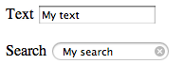
Web Forms
Search field
The search type is very similar to the text one
The difference is primarily stylistic
<p>
<label>
Search <input type="search" />
</label>
</p>

Slide 32
Web Forms
Telephone field
The tel type represents a control for editing a telephone number
The type doesn’t enforce a particular syntax to support all the format variety around the world
<p>
<label>
Telephone <input type="tel" />
</label>
</p>

Slide 33
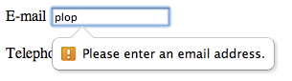
Web Forms
Email field
The email type represents a control for editing an email address
<p>
<label>
E-mail <input type="email" />
</label>
</p>

Slide 34
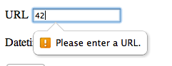
Web Forms
URL field
The url type represents a control for editing a single absolute URL
<p>
<label>
URL <input type="url" />
</label>
</p>

Slide 35
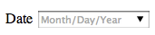
Web Forms
Date field
The date type represents a control for setting the element's value to a specific date
<p>
<label>
Date <input type="date" />
</label>
</p>

Slide 36
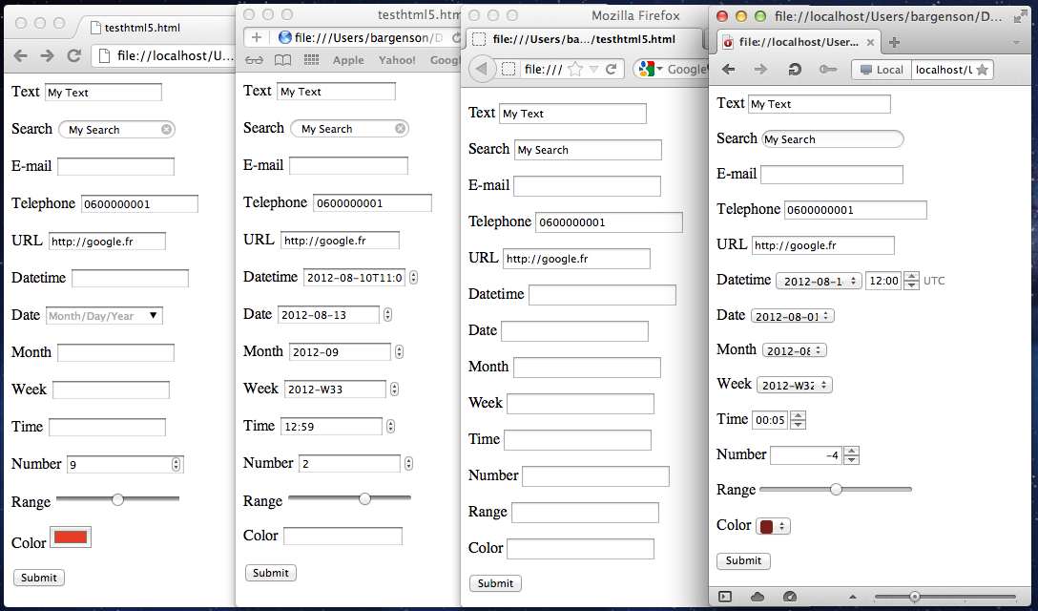




HTML5 markups
Web Forms

Slide 37
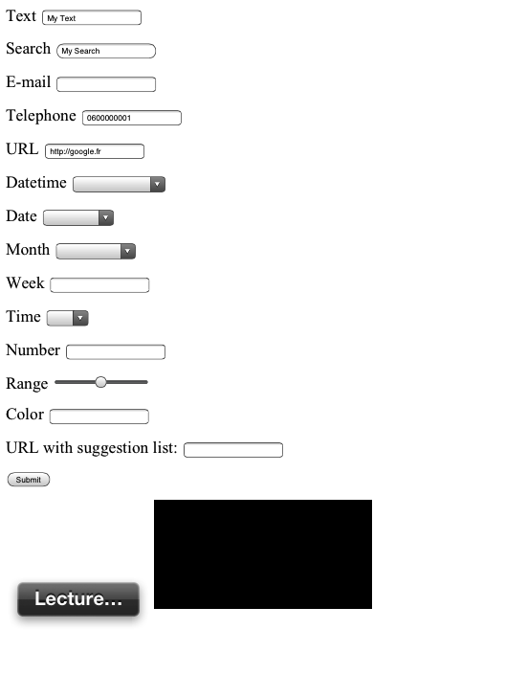
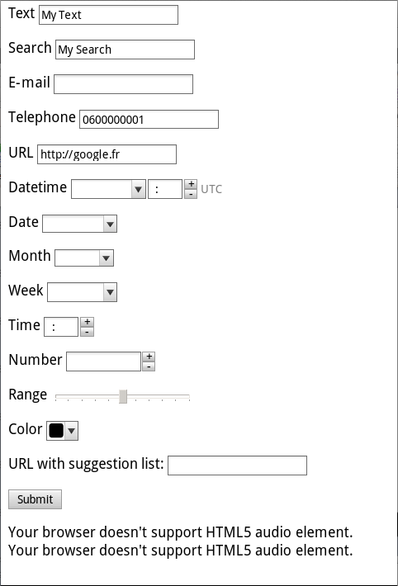


Notes:
Mobile browsers change UI in order to be more usable : sliders, custom keyboards (phone, url, datepicker), etc

Slide 38
Web Forms
Auto-completion
The new list attribute allows you to defined suggestions to the user
The attribute must refer to a datalist id containing the suggestions
You can use Ajax to update the datalist content in function of the user input if you need to

Slide 39
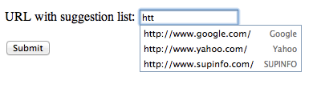
Web Forms
Auto-completion
<label>
URL with suggestion list:
<input type="url" list="hpurls">
</label>
<datalist id="hpurls">
<option value="http://www.google.com/" label="Google">
<option value="http://www.yahoo.com/" label="Yahoo">
<option value="http://www.supinfo.com/" label="SUPINFO">
</datalist>

Slide 40
Questions ?

Slide 41

Media markups
HTML5 - New markups

Slide 42
Media Markups
Audio & Video
There are more and more Audio and Video on the web
Until now, you had to use non standardize technologies like Java Applets or Flash
Need specific plug-in

Slide 43
Media Markups
Audio
The audio new element represents a sound or audio stream
Content may be provided inside the audio element
User agents should show this content to the user only if they don’t support the audio element

Slide 44

Media Markups
Audio
Example :
<audio src="http://images.wikia.com/starwars/images/3/38/UlicFalls.ogg" controls>
Your browser doesn't support the HTML5 audio element.
</audio>

Slide 45
Media Markups
Video
The new video element is used for playing videos and audio files with captions
Again, content may be provided inside the video element
User agents should show this content to the user only if they don’t support the video element

Slide 46

Media Markups
Video
Example :
<video src="myVideo.mp4" poster="movie.jpg" controls>
Your browser doesn't support the HTML5 video element.
</video>

Slide 47
Media Markups
Common attributes
audio and video have some common attributes
preload: to pre-download the media resource
autoplay: to automatically begin playback of the media resource

Slide 48
Media Markups
Common attributes
audio and video have some common attributes
controls: to ask to the user agent to provide its own set of controls
loop: to seek back to the start of the media resource upon reaching the end

Slide 49
Media Markups
Alternative sources
The source element allows to specify multiple alternative of sources to a media element
Allows the browser to choose the better source based on its media type or codec support

Slide 50
Media Markups
Alternative sources
Example:
<audio controls autoplay loop>
<source src="song.ogg" type="audio/ogg" />
<source src="song.mp3" type="audio/mpeg" />
Your browser doesn't support the HTML5 audio element.
</video>

Slide 51
Media Markups
Support for audio codecs
Browser | Version | Codec Support
Internet Explorer | 9.0+ | MP3, AAC
Firefox | 3.6+ | Ogg Vorbis, WAV
Google Chrome | 6.0+ | Ogg Vorbis, MP3, WAV (since Chrome 9)
Apple Safari | 5.0+ | MP3, AAC, WAV
Opera | 10.0+ | Ogg Vorbis, WAV
Android | 2.3+ | MP3, AAC (device dependent)
iOS | 3.0+ | MP3, AAC
Blackberry | 6.0+ | MP3, AAC
Notes:
http://html5doctor.com/html5-audio-the-state-of-play/

Slide 52
Media Markups
Support for video codecs
Browser | Version | Codec Support
Internet Explorer | 9.0+ | MP4
Firefox | 4.0+ | WebM, Ogg
Google Chrome | 6.0+ | MP4, WebM, Ogg
Apple Safari | 5.0+ | MP4
Opera | 10.6+ | WebM, Ogg
Android | 2.3+ | MP4, WebM (since 4.0)
iOS | 3.0+ | MP4
Notes:
http://www.longtailvideo.com/html5/formats/

Slide 53
Media Markups
Capture attribute
Input tags now have the capture attribute
Works with attribute type set to “file”
Allows to take picture with a camera
<input type="file" accept="image/*" capture="camera">

Slide 54
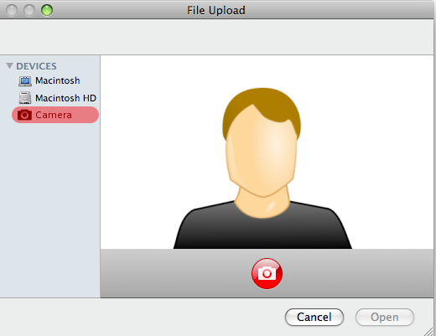
Media Markups
Capture attribute
Rendering example

Slide 55
Questions ?

Slide 56
Media Markups
Exercise (1/2)
Let’s design a simple HTML5 Media Player !
Create a simple HTML5 page with a video element and a simple form to enter a media URL
When the form is submit, the video element must play the media
Notes:
Tip: use “filetype:mp4” expression on Google to find video

Slide 57

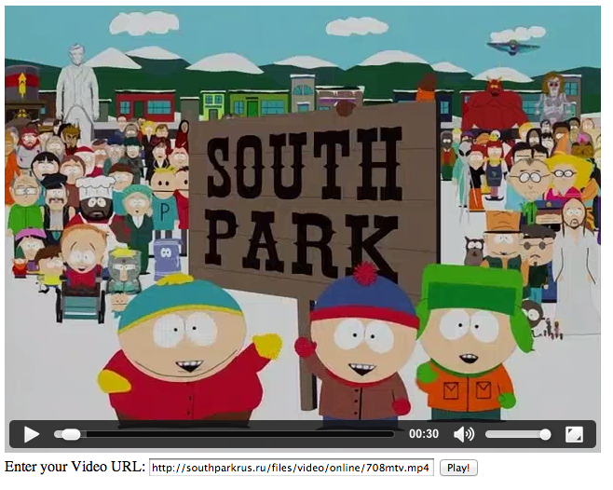
Media Markups
Exercise (2/2)

Slide 58

ARIA
HTML5 - New markups

Slide 59
ARIA
Introduction to widgets
HTML has native support for only a few user interface controls
Links and form elements
More and more webapps use widgets
More complex controls
Combination of HTML elements and script

Slide 60
ARIA
Introduction to widgets
A control have:
A role (purpose)
Properties (state)
A script can change them on native HTML elements in order to create custom widgets

Slide 61
ARIA
Introduction to widgets
For example, look at the following HTML code :
With some styles and scripts, we can transform those elements into a widget
<div id="tb-1" class="toolbar">
<button type="button">Print</button>
<button type="button">Move</button>
<button type="button">Delete</button>
</div>

Slide 62
ARIA
Introduction to widgets
Other example:
<ul class="tree">
<li class="treeitem">Item 1</li>
<li class="presentation">
<a href="#group-1" class="treeitem">Item 2</a>
<ul class="group">
<li class="treeitem">Item 2-1</li>
<li class="treeitem">Item 2-2</li>
</ul>
</li>
</ul>

Slide 63
ARIA
Widget & Accessibility
We saw how to write HTML by using the proper semantic elements and attributes
Necessary in order to expose element semantics to assistive technology
But how to exposed widgets to these technology ?

Slide 64
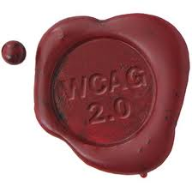
ARIA
Widget & Accessibility
W3C addressed this issue in Web Content Accessibility Guidelines (WCAG) 2.0
With the ARIA specification !

Slide 65
ARIA
Accessibility with ARIA
ARIA for Accessible Rich Internet Applications
W3C specification to improve the accessibility of custom widgets
Focus on dynamic content and UI components
Ajax, HTML, JavaScript and related technologies

Slide 66
ARIA
Accessibility with ARIA
Provides additional semantics beyond what is available in current implementations of HTML
Bridging technology filling gaps between versions of the HTML specs
Neither HTML 4 or 5 provide a toolbar or dialog widget, but both can be declared using ARIA

Slide 67
ARIA
Role attribute
For example, our previous toolbar can be declared like that:
<div id="tb-1" role="toolbar">
<button type="button">Print</button>
<button type="button">Move</button>
<button type="button">Delete</button>
</div>

Slide 68
ARIA
Role attribute
The role attribute document the purpose of the control
Can only be set to one of several predefined values
When building custom widgets always start with the closest native semantics and supplement with ARIA

Slide 69
ARIA
Role attribute: Widget Roles
The following roles act as standalone UI widgets or as part of composite widgets :
alert
alertdialog
button
checkbox
dialog
gridcell
link
marquee
menuitem
menuitemcheckbox
menuitemradio
option
progressbar
radio
scrollbar
slider
spinbutton
status
tab
tabpanel
textbox
timer
tooltip
treeitem

Slide 70
ARIA
Role attribute: Document Structure
The following roles describe structures that organize content in a page
Document structures are not usually interactive
article
columnheader
definition
directory
document
group
heading
img
list
listitem
math
note
presentation
region
row
rowheader
separator
toolbar

Slide 71
ARIA
Role attribute
Other example:
<ul role="tree">
<li role="treeitem">Item 1</li>
<li role="presentation">
<a href="#group-1" role="treeitem">Item 2</a>
<ul role="group">
<li role="treeitem">Item 2-1</li>
<li role="treeitem">Item 2-2</li>
</ul>
</li>
</ul>

Slide 72
<figure role="img" aria-labelledby="fish-caption">
<pre>
o .'`/
' / (
O .-'` ` `'-._ .')
_/ (o) '. .' /
) ))) >< <
`\ |_\ _.' '. \
'-._ _ .-' '.)
jgs `\__\
</pre>
<figcaption id="fish-caption">
Joan G. Stark, "<cite>fish</cite>".
</figcaption>
</figure>
Other example:
Other example
Notes:
ASCII art, which is really an image, appears to be text, and in the absence of appropriate annotations would end up being rendered by screen readers as a very painful reading of lots of punctuation. Using ARIA features, one can instead make the ATs skip the ASCII art and just read the caption.

Slide 73
ARIA
ARIA attributes
As you can see in the last example, ARIA widgets can have attributes
ARIA attributes are always prefixed by "aria-"
<ul role="tree" aria-multiselectable="true">...</ul>

Slide 74
ARIA
ARIA attributes
ARIA attributes can be :
States
Properties
Some available attributes:
aria-autocomplete
aria-checked
aria-describedby
aria-disabled
aria-haspopup
aria-label
aria-labelledby
aria-selected
…
Notes:
All the ARIA attributes are available here: http://www.w3.org/TR/wai-aria/states_and_properties

Slide 75
ARIA
ARIA attributes
Three ways to label a widget :
<label> element
<label for="male">Male</label>
<input type="radio" name="sex" id="male" />

Slide 76
ARIA
ARIA attributes
Three ways to label a widget :
aria-label attribute
<input type="checkbox" aria-label="Message 1"
title="Click to select this message" />

Slide 77
ARIA
ARIA attributes
Three ways to label a widget :
aria-labelledby attribute
<div role="alertdialog" aria-labelledby="hd">
<form>
<fieldset>
<legend id="hd">Confirm Action</legend>
<p>Are you sure you want to submit this form?</p>
<input type="button" value="OK"> ...
</fieldset>
</form>
</div>

Slide 78
ARIA
Styling States and Properties
ARIA widgets states and properties are unmanaged
Developers are responsible for defining the visual style associated with widget states and properties
In order to do that, you can use CSS Attribute Selectors using ARIA attributes

Slide 79
ARIA
Styling States and Properties
Example:
a[aria-expanded=true] + ul[role=group] {
display: block;
}
a[aria-expanded=false] + ul[role=group] {
display: none;
}

Slide 80
Questions ?

Slide 81

Microdata
HTML5 - New markups

Slide 82
Microdata
Presentation
Specification used to nest semantics within existing content on web pages
Used to provide a richer browsing experience for users
Can be extracted and processed by:
Search engines
Web crawlers
Browsers
…

Slide 83
Microdata
Presentation
You can label your content to describe a specific type of information
Articles
Events
Person information
…

Slide 84
Microdata
Presentation
Each information type describes a specific type of item
For example, an event has the properties :
Venue
Starting time
Name
…

Slide 85
Microdata
Presentation
The specification introduces simple attributes in HTML tags:
Assign brief and descriptive names to items and properties
<div itemscope itemtype="http://data-vocabulary.org/Person">
My name is <span itemprop="name">Bob Smith</span> but people call me <span itemprop="nickname">Smithy</span>. Here is my home page:
<a href="http://www.example.com" itemprop="url">
www.example.com
</a>
</div>

Slide 86
Microdata
Attributes
itemscope :
An element with this attribute specified creates a new item, a group of name-value pairs
Elements creating new items may have an itemtype attribute

Slide 87
Microdata
Attributes
itemtype :
A valid URL of a vocabulary that describes the item and its properties context
A collection of commonly used (and Google Supported) vocabularies are located at:
http://www.schema.org

Slide 88
Microdata
Attributes
itemid :
Optional, indicates a unique identifier of the item
<dl itemscope itemtype="http://vocab.example.net/book"
itemid="urn:isbn:0-330-34032-8">
...
</dl>

Slide 89
Microdata
Attributes
itemref :
Properties that are not descendants of the element with the itemscope attribute can be associated with the item using this attribute
Provides a list of element itemids with additional properties elsewhere in the document

Slide 90
Microdata
Attributes
The following snippets are equivalent :
<div itemscope>
<p itemprop="a">1</p>
<p itemprop="a">2</p>
<p itemprop="b">test</p>
</dl>
<div id="x">
<p itemprop="a">1</p>
</div>
<div itemscope itemref="x">
<p itemprop="b">test</p>
<p itemprop="a">2</p>
</div>

Slide 91
Microdata
Attributes
itemprop :
Indicates that its containing tag holds the value of the specified item property
The properties name and value context are described by the item vocabulary

Slide 92
Microdata
Attributes
Example:
<dl itemscope itemtype="http://vocab.example.net/book"
itemid="urn:isbn:0-330-34032-8">
<dt>Title</dt>
<dd itemprop="title">The Reality Dysfunction</dd>
<dt>Author</dt>
<dd itemprop="author">Peter F. Hamilton</dd>
</dl>

Slide 93
Microdata
Rich Snippets Testing Tool
Go to :
http://www.google.com/webmasters/tools/richsnippets
Test some of the provided examples

Slide 94
Questions ?

Slide 95
Microdata
Exercise (1/2)
Let’s design a simple widget: an HTML5 event manager!
Create a form asking some information:
Event:
Name, start date, end date
Location:
City, postal code, box number and street
Use HTML5 new input types & validation attributes

Slide 96
Microdata
Exercise (2/2)
Let’s design a simple widget: an HTML5 event manager!
Display data inside an HTML dialog on submit
Be creative for the design!
Use microdata to each property
Use ARIA role and label on dialog box
Validate your HTML code with W3C validator and Rich Snippet Testing Tool

Slide 97


